Slide 1

Synthetic Biology Open Language: Data Model version 3
Presenter: Jacob Beal (Raytheon BBN)
September 11th, 2023
IWBDA, Boston, MA, USA
Editors: Lukas Buecherl (U. Colorado), Tom Mitchell (Raytheon BBN), Gonzalo Vidal Peña (Newcastle University), Georgie Hau Sorensen (U. Bristol), Carolus Vitalis (U. Colorado)
Chair: Prashant Vaidyananthan (Oxford Biomedica)
SBOL Development Group: ~180 members from more than 100 academic and industrial organizations.

Slide 2



Tutorial Resources
Follow Along in Python:
https://colab.research.google.com/github/SynBioDex/SBOL-Notebooks/blob/main/iwbda_2023_examples.ipynb
Download slides:
https://github.com/SynBioDex/Community-Media/tree/master/2023/IWBDA23
SBOL 3.1 Specification Document:
https://sbolstandard.org/docs/SBOL3.1.0.pdf

Slide 3
What is SBOL?
SBOL actually consists of two standards:
SBOL Data model Focus of this tutorial
a formalized representation of data objects
SBOL Visual Tutorial later today
a standardized set of schematic symbols for genetic design
To guarantee interoperability between tools and standards, SBOL leverages ontologies, such as the Sequence Ontology (SO) and Systems Biology Ontology (SBO).

Slide 4
Milestones in the history of SBOL
Kick-off at a computational synthetic biology workshop at the University of Washington
Apr, 2008
The SBOL Developers Group was officially established with adoption of formal rules of governance and election of editors
Jun, 2011
First version of the SBOL data model was released
(BB FRFC 84)
Sep, 2011
First version of the SBOL Visual standard was released
(BBF RFC 93)
Mar, 2013
SBOL Version 2.0 was officially released
(BBF RFC 108)
Jul, 2015
Jun, 2016
ACS Synthetic Biology adopts SBOL as publication standard
SBOL Visual 2.0 officially released
SBOL Version 2.2 supports complete design-build-test cycle
Dec, 2017
Mar, 2020
SBOL Version 3.0 officially released

Slide 5
Unified representation of biological design
FASTA
Raw sequence information
GenBank
Contains sequence features
SBOL 1
Hierarchical, partially known structure
SBOL 2
Functional interactions and modules
Other molecules and compounds
Design libraries
SBOL 3
Complete design-build-test-learn cycle
Simpler and more succinct models
Full combinatorial designs

Slide 6
Unified representation of biological design
FASTA
Raw sequence information
GenBank
Contains sequence features
SBOL 1
Hierarchical, partially known structure
SBOL 2
Functional interactions and modules
Other molecules and compounds
Design libraries
SBOL 3
Complete design-build-test-learn cycle
Simpler and more succinct models
Full combinatorial designs
GFF3 is hierarchical & known

Slide 7
Unified representation of biological design
FASTA
Raw sequence information
GenBank
Contains sequence features
SBOL 1
Hierarchical, partially known structure
SBOL 2
Functional interactions and modules
Other molecules and compounds
Design libraries
SBOL 3
Complete design-build-test-learn cycle
Simpler and more succinct models
Full combinatorial designs
GFF3 is hierarchical & known

Slide 8
Unified representation of biological design
FASTA
Raw sequence information
GenBank
Contains sequence features
SBOL 1
Hierarchical, partially known structure
SBOL 2
Functional interactions and modules
Other molecules and compounds
Design libraries
SBOL 3
Complete design-build-test-learn cycle
Simpler and more succinct models
Full combinatorial designs
GFF3 is hierarchical & known

Slide 9
SBOL Data Model – Version 3
Core Design Classes
Complete Data Model

Slide 10
SBOL Visual 3
Grey text and lines (including this) are annotations
SBOL Visual integrates with SBOL Data Model via an ontology

Slide 11
SBOL assists in collaboration throughout workflows
LEARN

Slide 12
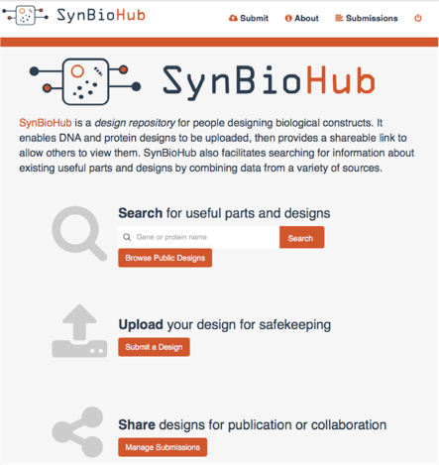


Data Repositories: SynBioHub
James McLauglin
Anil Wipat
Zach Zundel
Chris Myers

Slide 13
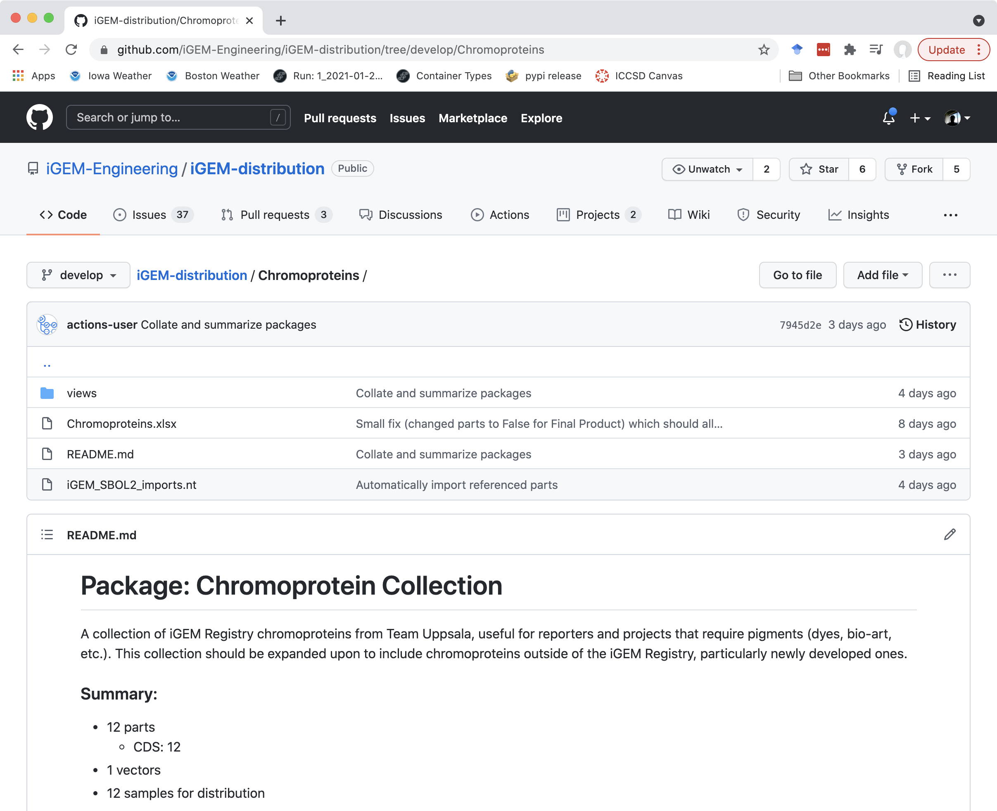
Data Repositories: git

Slide 14
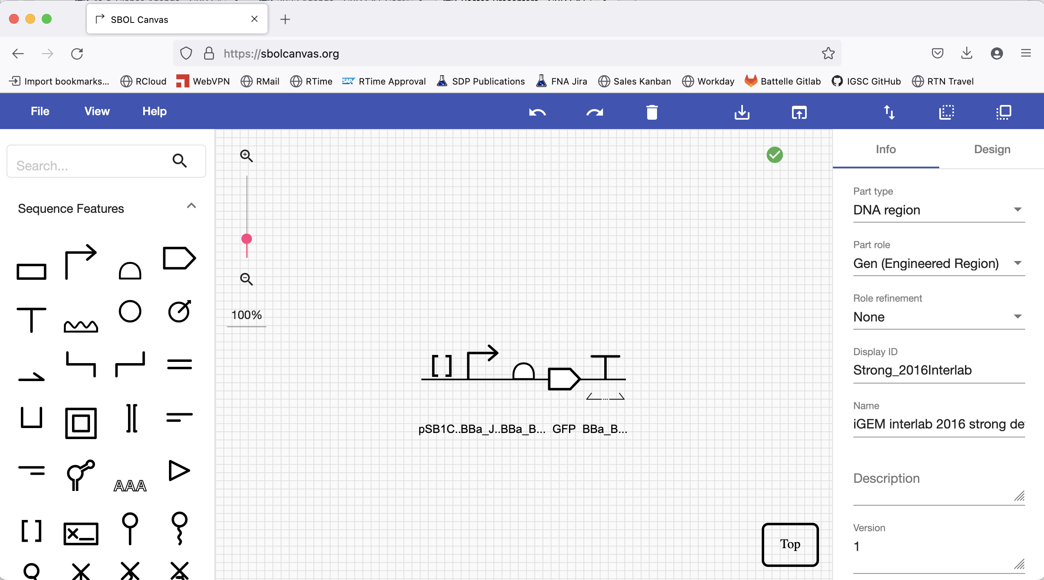
Sequence Editor: SBOL Canvas
Terry, et al. ACS SynBio (2021)
Other sequence editors that support SBOL include: SBOL Designer, DeviceEditor, J5, VectorEditor, DNAPlotLib, Eugene, GenoCAD, BOOST (JGI), etc.

Slide 15
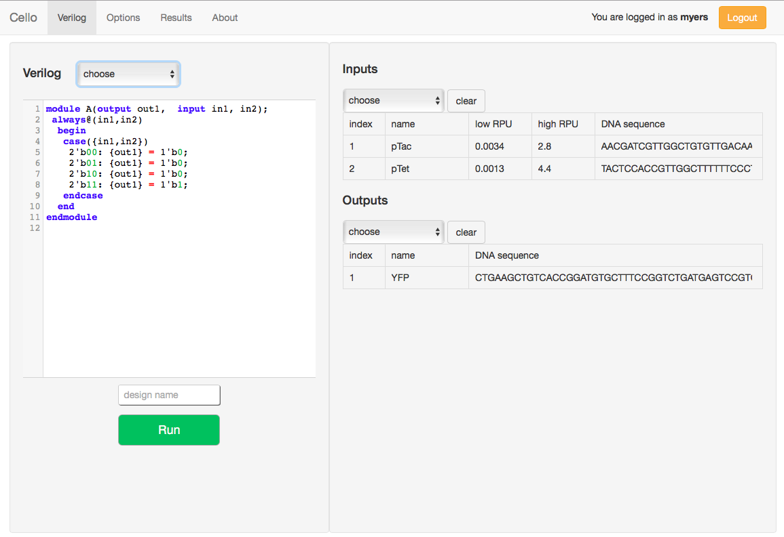
Circuit Design Tools: Cello
Nielsen et al., Science (2016)

Slide 16
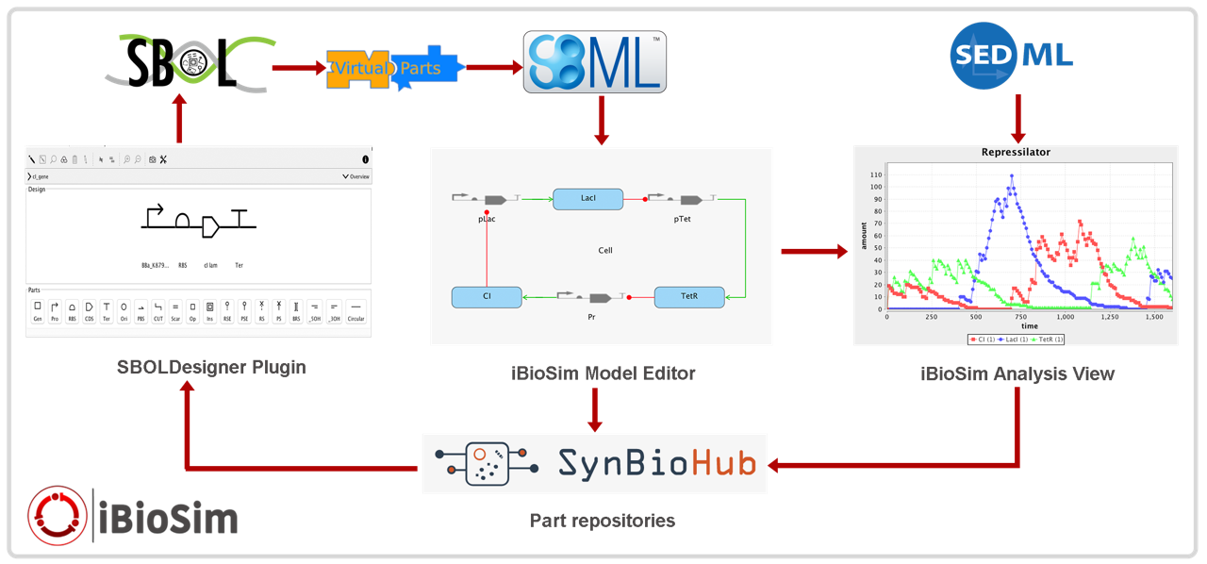
Circuit Design Tools: iBioSim
Madsen et al., IEEE Design & Test (2012)

Slide 17
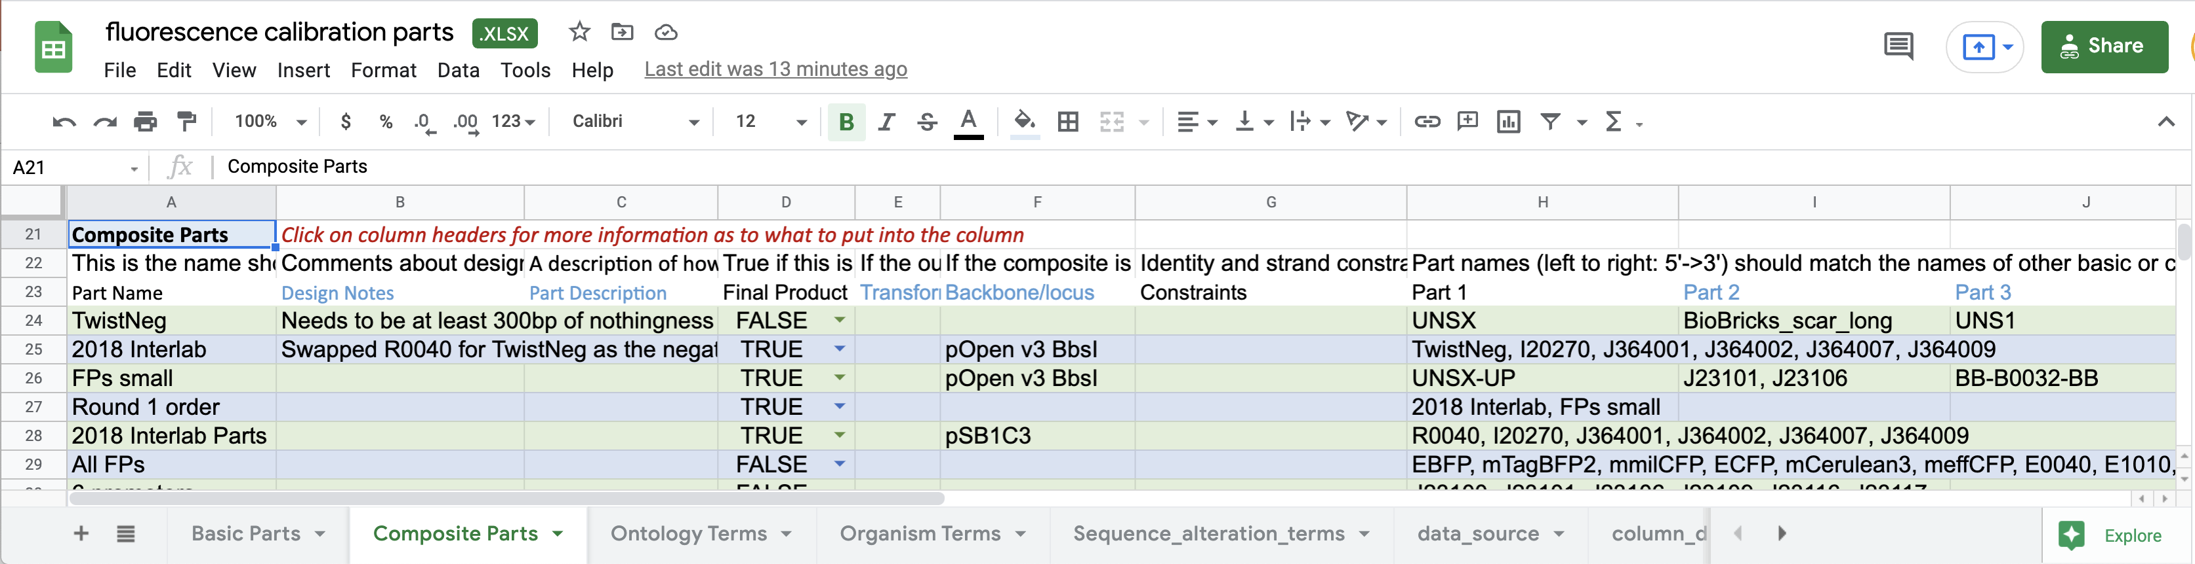
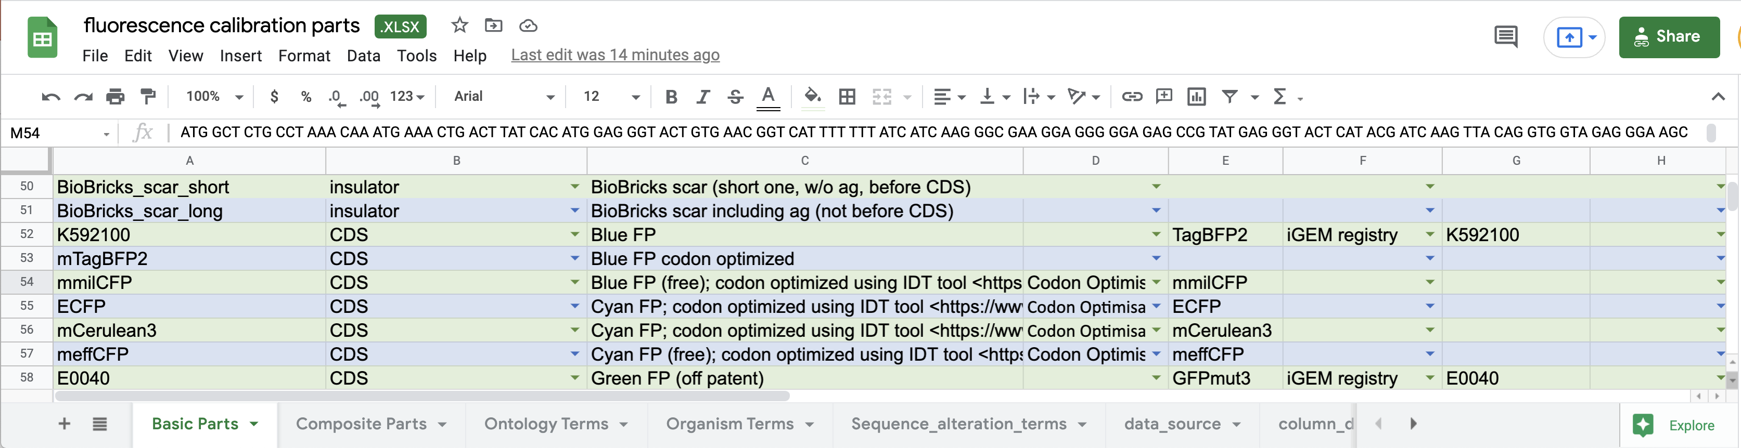
Build & Test Planning: Excel-to-SBOL

Slide 18


SBOL Community Structure
sbol-announce@googlegroups.com
people who want to know what’s going on with SBOL
sbol-dev@googlegroups.com
people interested in contributing to standards, tools
https://tinyurl.com/sbol-slack
community
managers
Editors
Chair
strategic
leadership
SBOL Industrial
Steering Comm.
Advisory Panel
Industrial user group
PIs helping chair
External perspective

Slide 19









SBOL Industrial Consortium
Pre-competitive organization:
Companies investing in SBOL
Coordination of priorities, sharing of best practices
Support community infrastructure & development

Slide 20
How to get involved
Use SBOL & SBOL Visual!
Report issues and get help when you need it
Join Slack, sbol-announce, sbol-dev
Organizations: join SBOL Industrial
Develop or contribute to libraries & tools
Help improve the standards
Help govern the community

Slide 21
SBOL Data Model – Version 3
Core Design Classes
Complete Data Model

Slide 22
Preliminaries: RDF & URIs
SBOL3 builds on the Resource Description Framework (RDF)
RDF represents data as graphs of “Subject / Verb / Object” triples
“Plasmid-7 hasFeature EcoRI-cuts-after-1780”
“Cell-type-1 contains Plasmid-7”
“FlowCytometry-B7.fcs wasDerivedFrom Sample-B7”
Universal representation: can store any data or knowledge
Open and extensible, integrates well with other databases & ontologies
Many well-established free & open libraries
Standard serialization to/from XML, JSON, triples, Turtle, …
URIs / IRIs → globally unique name for objects (URL or UUID)
URI structure & namespaces

Slide 23
Preliminaries: Data Types & Diagrams
Primitive data types: String, Integer, Long, Double, Boolean
RDF defines these via standard W3C XML primitive types
Class diagrams:

Slide 24
Preliminaries: Identifiers & Namespaces
Every SBOL object subclasses Identified
TopLevel subclasses stand on their own
Others are child objects nested in a TopLevel
SBOL requires a specific URL structure:
TopLevel: [namespace]/[local]/[displayId]
https://synbiohub.org/public/igem/BBa_J23070
Child: [parent]/[displayId] (recursively)
https://synbiohub.org/public/igem/BBa_J23070/annotation1
https://synbiohub.org/public/igem/BBa_J23070/annotation1/loc1
Namespace objects distinguish namespace/local, simplify object transfer
local identifier
human friendly

Slide 25
Component: the root of every design
Nucleic acid sequence,
Amino acid sequence,
SMILES, etc…
Pointers to
numerical models
Parts
Abstractions
Functional
interactions
Topology
& identity
A component can be DNA, RNA, protein, a small molecule, a strain of cells, a media recipe, an experimental sample design, …
Indicated by type + role

Slide 26
Example: GFP expression cassette
Component
identity: iGEM#I13504
name: “iGEM 2016 interlab reporter”
description: “GFP expression cassette used for 2016 iGEM interlab”
type: SBO: DNA
role: SO: Engineered Region

Slide 27
Features: Structural aspects of a component
Pointers to non-SBOL
(e.g., ChEBI, UniProt)
Reusable parts
Pointers inside
SubComponents
Local annotations
(e.g., cut sites, scars)
In-context parts
& placeholders

Slide 28
Example: expression cassette parts
Component: iGEM#I13504
hasFeature
SubComponent
SubComponent
SubComponent
instanceOf
instanceOf
instanceOf
Component
identity: iGEM#B0034
name: RBS (Elowitz 1999)
type: SBO: DNA
role: SO: Ribosome Entry Site
Component
identity: iGEM#E0040
name: GFP
type: SBO: DNA
role: SO: CDS
Component
identity: iGEM#B0015
name: double terminator
type: SBO: DNA
role: SO: Terminator

Slide 29
Sequences & Locations
Inline or reverse complement
For introns, insertions,
origin-crossing
IUPAC NA, IUPAC AA,
SMILES, InChI, …
when just connecting
Component & Sequence
Between bases
(e.g., restriction site)
1 or more bases
(e.g., coding sequence)

Slide 30
Example: Location of a SubComponent
Component: iGEM#I13504
hasSequence
Sequence
encoding: EDAM: NA seq
elements: aaagagga…
hasFeature
hasLocation
SubC
instanceOf
hasSequence
Range
start: 738
end: 745
SequenceFeature
role: SO: Assembly Scar
C: iGEM#B0015
hasLocation
hasSequence
Range
start: 746
end: 875
Sequence
encoding: EDAM: NA seq
elements: ccaggcatca…

Slide 31
Functional Information: Interaction & Participation
e.g., genetic production,
biochemical reaction,
Inhibition, stimulation, …
Template, product,
reactant, inhibitor,
inhibited, …

Slide 32
Example: GFP production from expression cassette
Component: iGEM#I13504-System
GFP
hasFeature
SubC
instanceOf
hasFeature
hasInteraction
SubC
Interaction:
type: SBO: Genetic Production
inChildOf
ComponentReference
participation
Participation:
role: SBO: Template
Participation:
role: SBO: Product
instanceOf
participant
participant
hasFeature
C: iGEM#I13504
Component: GFP
type: SBO: Protein
GFP

Slide 33
Constraint: Topology & Identity
Classes of restriction include:
- Identity
e.g., verifyIdentical, differentFrom, replaces
- Relative orientation
e.g., sameOrientationAs, oppositeOrientationAs
- Topological relations
e.g., contains, meets, overlaps
- Sequence order
e.g., precedes, equals, contains, starts, finishes

Slide 34
Example: concatenating & reusing components
C: iGEM#interlab16device1
C: iGEM#interlab16device2
GFP
GFP
hasConstraint
hasFeature
hasConstraint
hasFeature
CT: meets
CT: meets
subject
object
inChildOf
inChildOf
object
subject
SubC
CR
SubC
SubC
CR
SubC
instanceOf
hasFeature
instanceOf
hasFeature
instanceOf
C: iGEM#J23101
C: iGEM#I13504-System
C: iGEM#J23106
GFP

Slide 35
Grouping Information: Collections
Collection:
identity: iGEM#interlab16
name: “iGEM 2016 interlab parts”
description: “Collection of parts used for 2016 iGEM interlab”
C: iGEM#interlab16device1
GFP
member
C: iGEM#interlab16device2
GFP
C: iGEM#interlab16device3
GFP
C: iGEM#interlab16positiveControl
GFP
C: iGEM#interlab16negativeControl

Slide 36
From Constructs to Strains
C: iGEM#Ecoli-with-interlab16device1
hasFeature
hasConstraint
hasConstraint
hasFeature
LocalSubComponent
subject
subject
CT: contains
CT: contains
CT: contains
object
subject
object
object
SubC
SubC
CR
CT: meets
SubC
subj
object
instanceOf
instanceOf
inChildOf
hasFeature
instanceOf
C: E. coli DH5-a
C: iGEM#interlab16device1
C: iGEM#pSB1C3
GFP
CamR

Slide 37
Interface: defining abstractions
C: iGEM#Ecoli-with-interlab16device1
hasInterface
output
Interface

Slide 38
Linking to External Models
C: iGEM#Ecoli-with-interlab16device1
hasModel
Model:
identity: my-iBioSim-ODE
source: https://synbiohub…
language: EDAM: SBML
framework: SBO: Continuous

Slide 39
Numerical information: Measure
Actual number
Unit
Nature of measurement
SBOL uses Ontology of Units of Measure (OM)
Measures can be added to any Identified object via “hasMeasure”

Slide 40
Example: design of an experimental sample
C: project#Sample1
hasFeature
SubC
instanceOf
Measure
om:hasNumericalValue: 200.0
om:hasUnit: om:microlitre
type: SBO: Volume
C: project#M9-Media
hasFeature
hasMeasure
SubC
instanceOf
C: iGEM#Ecoli-with-interlab16device1
ExternallyDefined
type: SBO: Simple chemical
definition: PubChem: Glucose
hasMeasure
hasMeasure
Measure
om:hasNumericalValue: 10000
om:hasUnit: om:count
type: SBO: Number of entities
Measure
om:hasNumericalValue: 2.5
om:hasUnit: om:milligram
type: SBO: Mass of entity pool

Slide 41
CombinatorialDerivation: libraries & experiments
Numbers to put
on the feature
Point to a feature
In the template
Hierarchical
substructure
Design with blanks
to be filled in
Values to replace
the feature

Slide 42
Example: studying effects of carbon source - template
C: project#SampleSpec
hasFeature
SubC
instanceOf
Measure
om:hasNumericalValue: 200.0
om:hasUnit: om:microlitre
type: SBO: Volume
C: project#M9-Media
hasFeature
hasMeasure
LocalSubComponent:
project#strain
LocalSubComponent:
project#carbonSource
hasMeasure
hasMeasure
Measure
om:hasNumericalValue: 10000
om:hasUnit: om:count
type: SBO: Number of entities
Measure
om:hasNumericalValue: 2.5
om:hasUnit: om:milligram
type: SBO: Mass of entity pool

Slide 43
Example: carbon source combinations
CombinatorialDerivation: project#VaryCarbon
strategy: sbol:enumerate
hasVariableFeature
template
hasVariableFeature
VariableFeature
cardinality: sbol:one
VariableFeature
cardinality: sbol:one
variable
variable
C: project#SampleSpec
LocalSubComponent:
project#strain
LocalSubComponent:
project#carbonSource
variantCollection
variant
Collection: iGEM#interlab16
C: arabinose
C: glucose
C: maltose
C: lactose

Slide 44
Relationships between information: Provenance
simplest link
link with
explanation
hook for linking descriptions of
protocols, tool executions, etc.
inputs
parameters
tool / person

Slide 45
Linking with samples and data
real-world aliquot
link to data, any format
wasDerivedFrom
links intention
Actual result
Experiment classes act as an “easy query” label on data

Slide 46
Example: a sample created in triplicate
C: project#Sample1
M9-media
glucose
built
built
built
Implementation
Implementation
Implementation
attachment
attachment
attachment
Attachment
Attachment
Attachment

Slide 47
Example: Linking Designs, Protocols, and Data
C: device1-pSB1C3
C: E. Coli DH5-Alpha
built
built
Implementation
Implementation
Activity:
transform
[Usage link]
C: M9-Media
C: glucose
built
built
Implementation
wasGeneratedBy
Implementation
Implementation
Activity:
culture
[Usage link]
C: project#Sample1
Description: E.coli transformed with device1-pSB1C3, grown in M9 Media
Implementation
built
wasGeneratedBy
attachment
Activity:
flow cytometry
[Usage link]
Attachment: fcs file
wasGeneratedBy

Slide 48
Converting to/from SBOL3
FASTA Component + Sequence
GenBank Component + Sequence
SBOL2 SBOL3*
*Except some known converter bugs

Slide 49
SBOL Data Model – Version 3
Core Design Classes
Complete Data Model

Slide 50
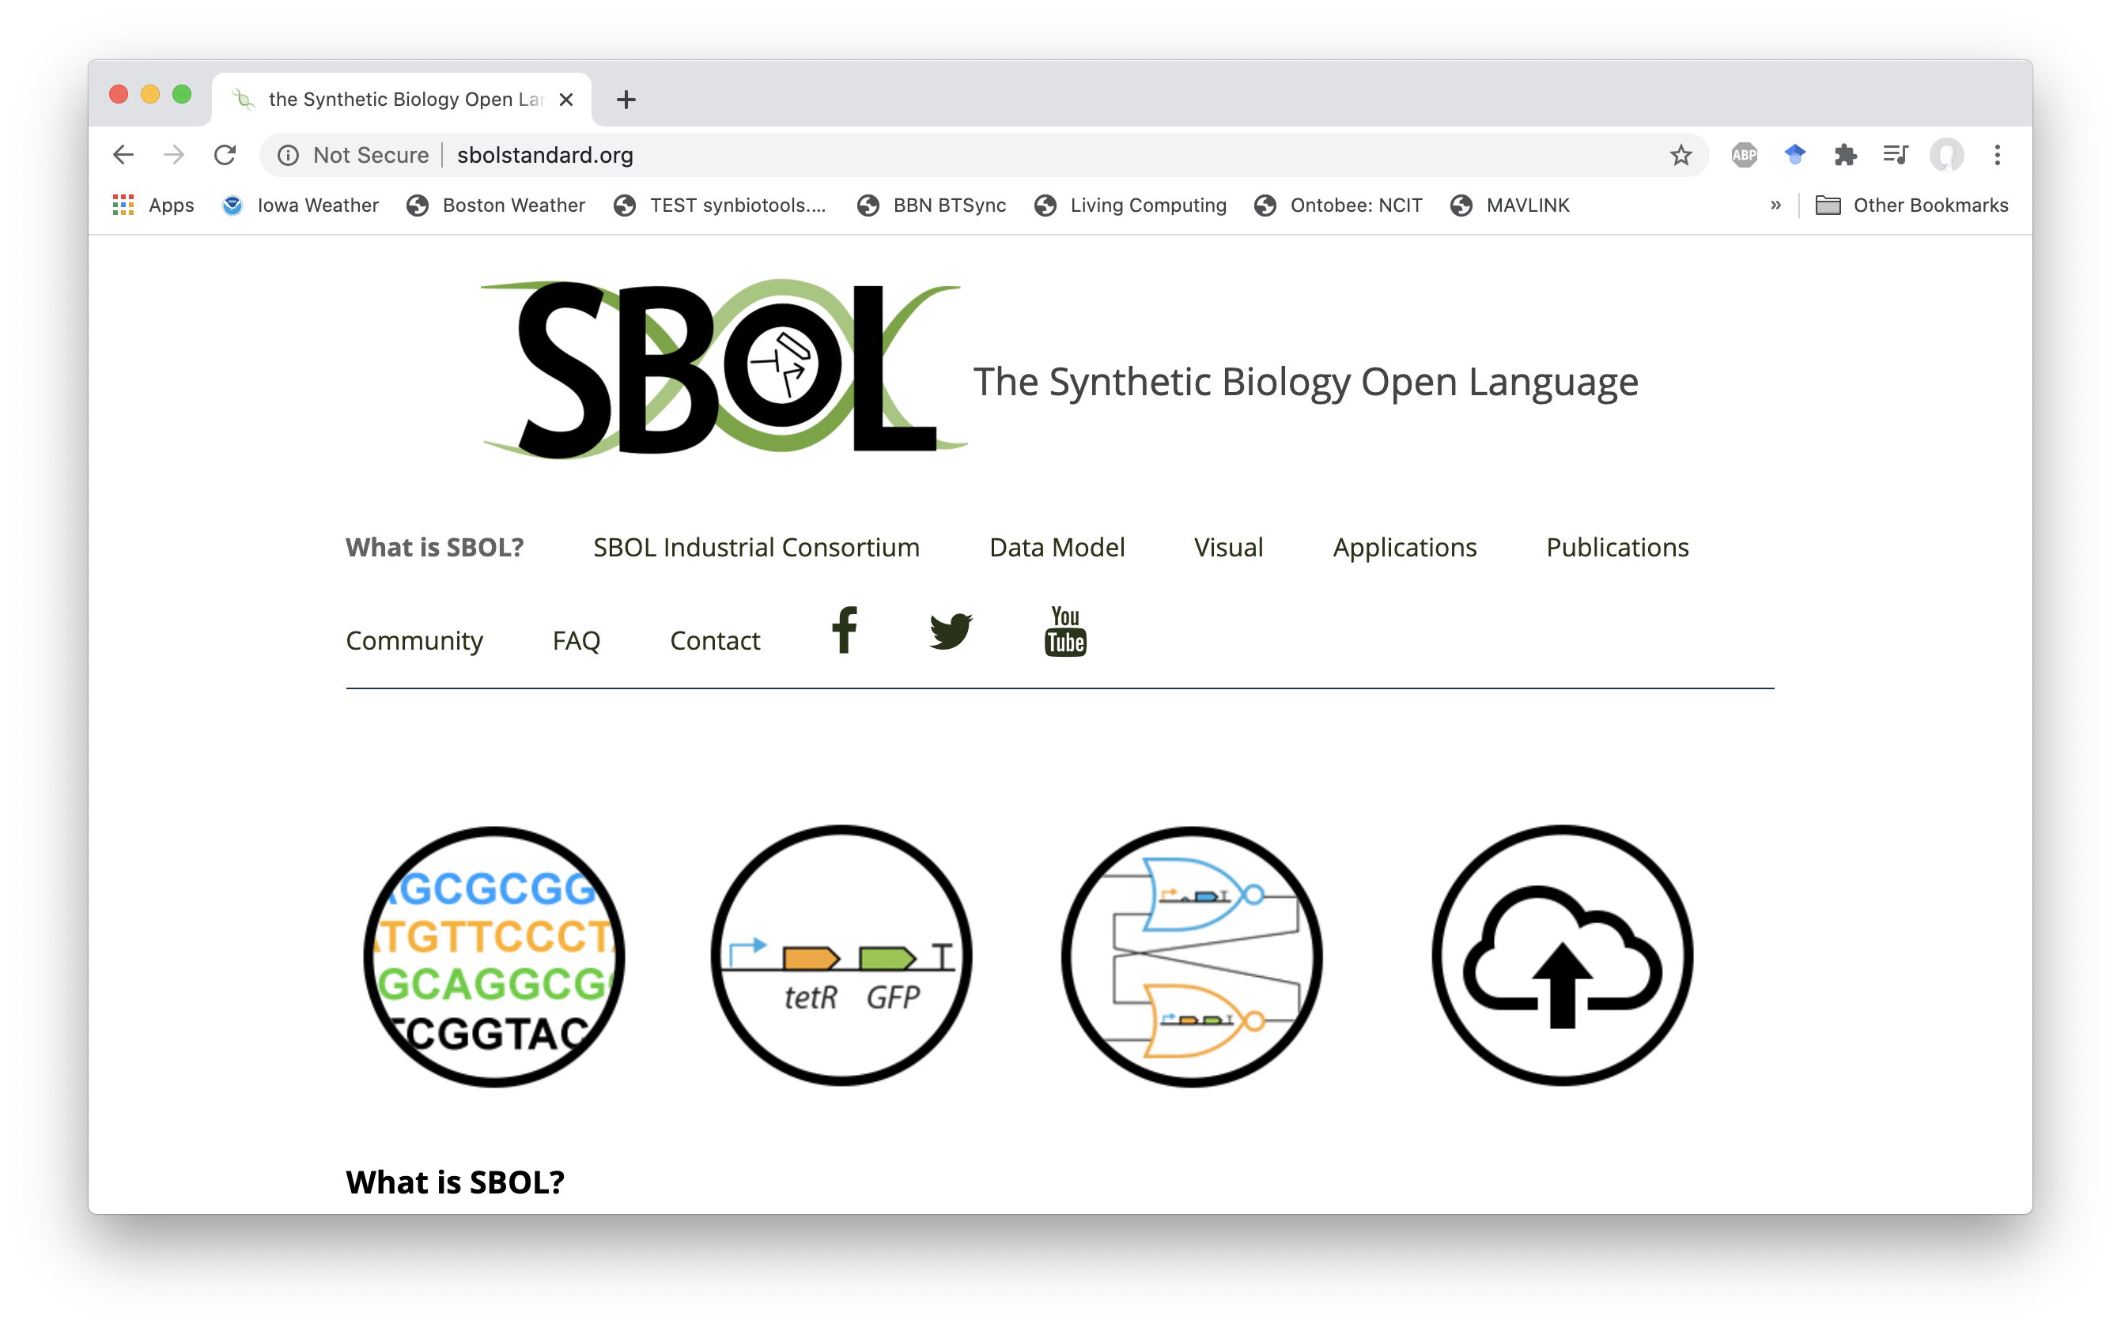
For more information: https://sbolstandard.org

Slide 51


Additional Resources: SBOL3 in Python
pySBOL3 v1.1 is currently available. Python 3 only.
Installation:
$ pip install sbol3
Repository: https://github.com/synbiodex/pySBOL3
Documentation: https://pysbol3.readthedocs.io/en/latest/
SBOL Utilities: https://github.com/SynBioDex/SBOL-utilities
Other libraries:
Java: libSBOLj 3.0 (https://goksel.github.io/libSBOLj3/)
JavaScript: sbolgraph (https://github.com/sboltools/sbolgraph)

Slide 52



Additional Resources: Working with Ontologies
Manually browse ontology terms:
Sequence Ontology:
http://www.sequenceontology.org/browser/obob.cgi
Systems Biology Ontology:
https://www.ebi.ac.uk/ols4/ontologies/sbo
Automated lookup tool:
TYTO
https://github.com/SynBioDex/tyto

